Slide 1
Common bone tumors
By
Dr Maghrabi Mohammed
Lecturer of orthopaedic surgery
MD AinShams university

Slide 2
Introduction

Slide 3
Classification:
Benign
Malignant
Primary
Secondary

Slide 4
Classification
Benign lesions are classified using Arabic numbers (1,2,3)
1 = latent lesion
e.g. non-ossifying fibroma
2 = active lesion
e.g. ABC
3 = aggressive lesion
e.g. giant cell tumor of bone

Slide 5
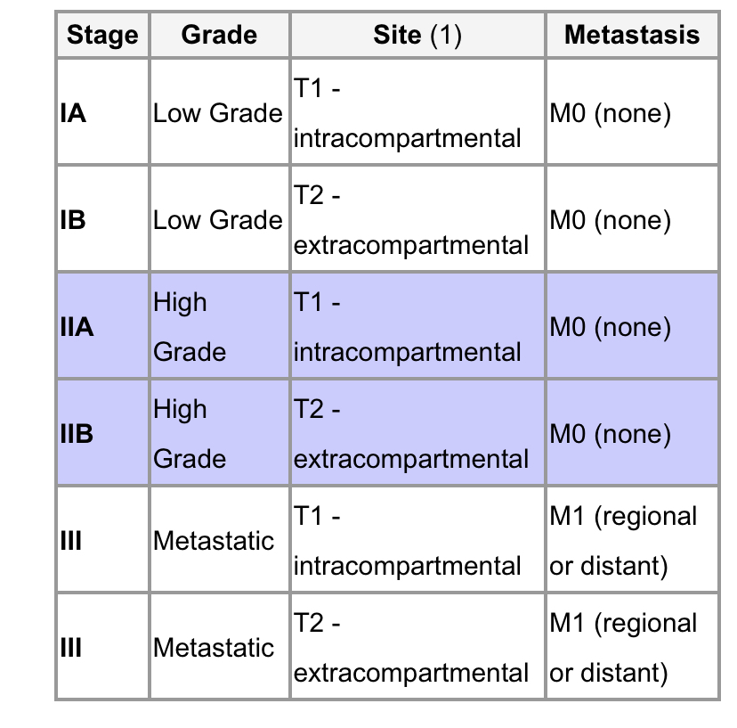
Classification of Malignant lesions
MSTS staging
Prognosis of bone cancer depends on the following variables
presence of metastasis
skip (discontinous) lesions within the same bone
histologic grade
tumor size

Slide 6
Diagnosis
History ( thyroid breast prostate)
Clinical examination : Thyroid Breasts Chest Liver Kidney Rectal (prostate & rectal tumours)
PXR CT MRI : affected bone
Angiography -> tumour blood supply and relationship to major vessels
CT : chest abd pelvis
Bone scan
Laboratory: CBC, ESR, LFT, C PH ALP, Tumor markers( AFP PSA), urine analysis
Electrophoresis
Biopsy

Slide 7
TREATMENTS
Non surgical treatment:
Observation
Chemotherapy
Radiotherapy
Hormonal therapy
Bisphosphonates

Slide 8
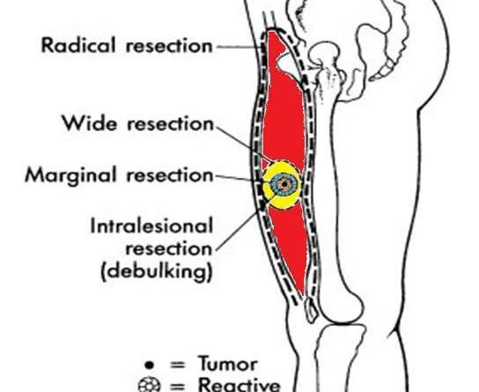
SURGICAL EXCISION
Intra-lesional
through the tumour
Marginal
through pseudo-capsule of tumour
Wide
around reactive zone, take a cuff of normal tissue
Radical
removal of entire compartment or compartments

Slide 9
Reconstructive options
biological methods including:-
Autograft or allograft
Tumor devitalized autograft or recycling (involves re-implantation of tumor-bearing bone after devitalized treatment (extracorporeal irradiation, heat treatment and freezing)
Fibular graft (Vascularized or non)
Non biological methods, using custom-made implants

Slide 10
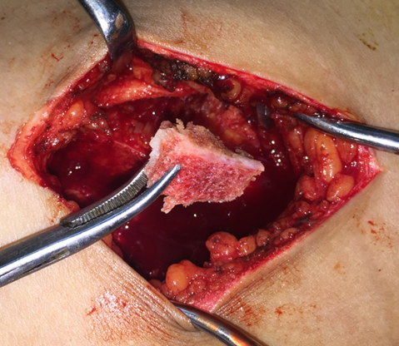
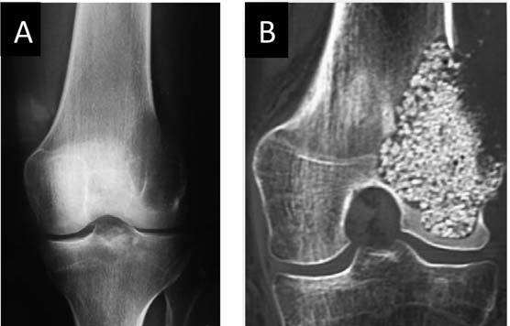
Bone graft

Slide 11
Recycling

Slide 13
Endoprosthesis

Slide 14
BENIGN LESIONS

Slide 15
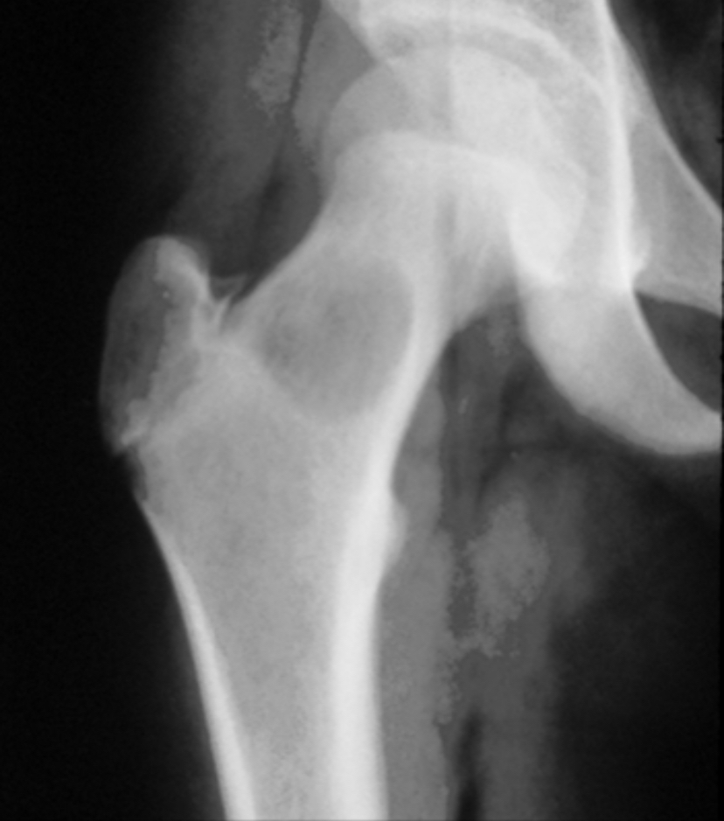
SIMPLE BONE CYST
1. Simple bone cyst
serous fluid-filled bone lesion
Age & location
usually found in the proximal humerus of young patients arises in the metaphysis adjacent to physis
Prognosis: decrease in size and may heal after growth is complete
Symptoms : most asymptomatic unless fracture occurs

Slide 16
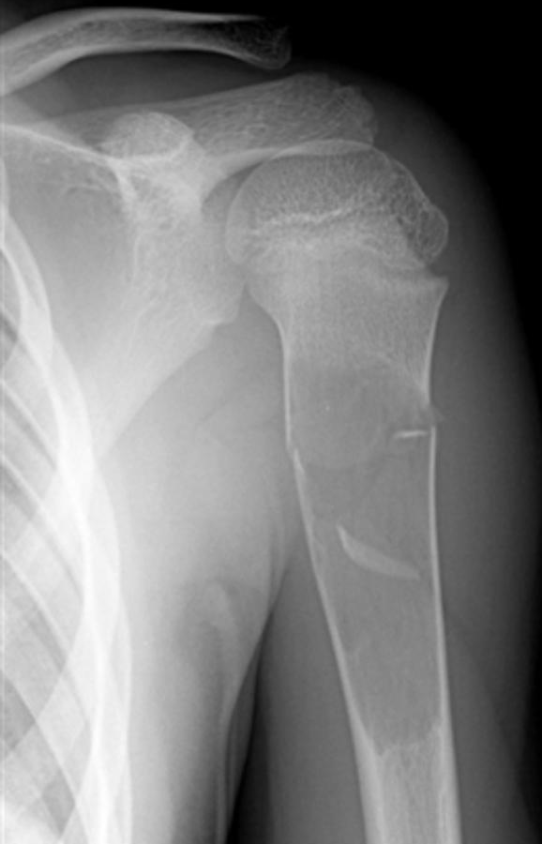
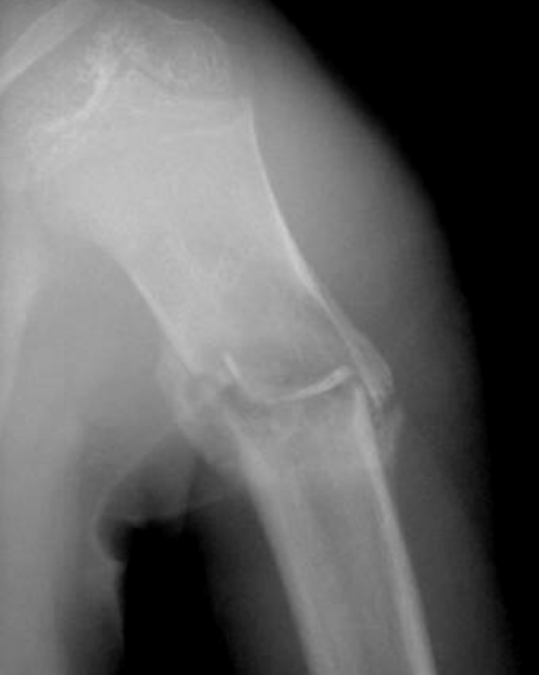
Investigations:-PXR
central, lytic, well-demarcatedmetaphyseal lesion
"fallen leaf" sign (pathologic fracture with fallen cortical fragment is pathognomonic
Treatment
Immobilization alone
Curettage and bone grafting

Slide 17
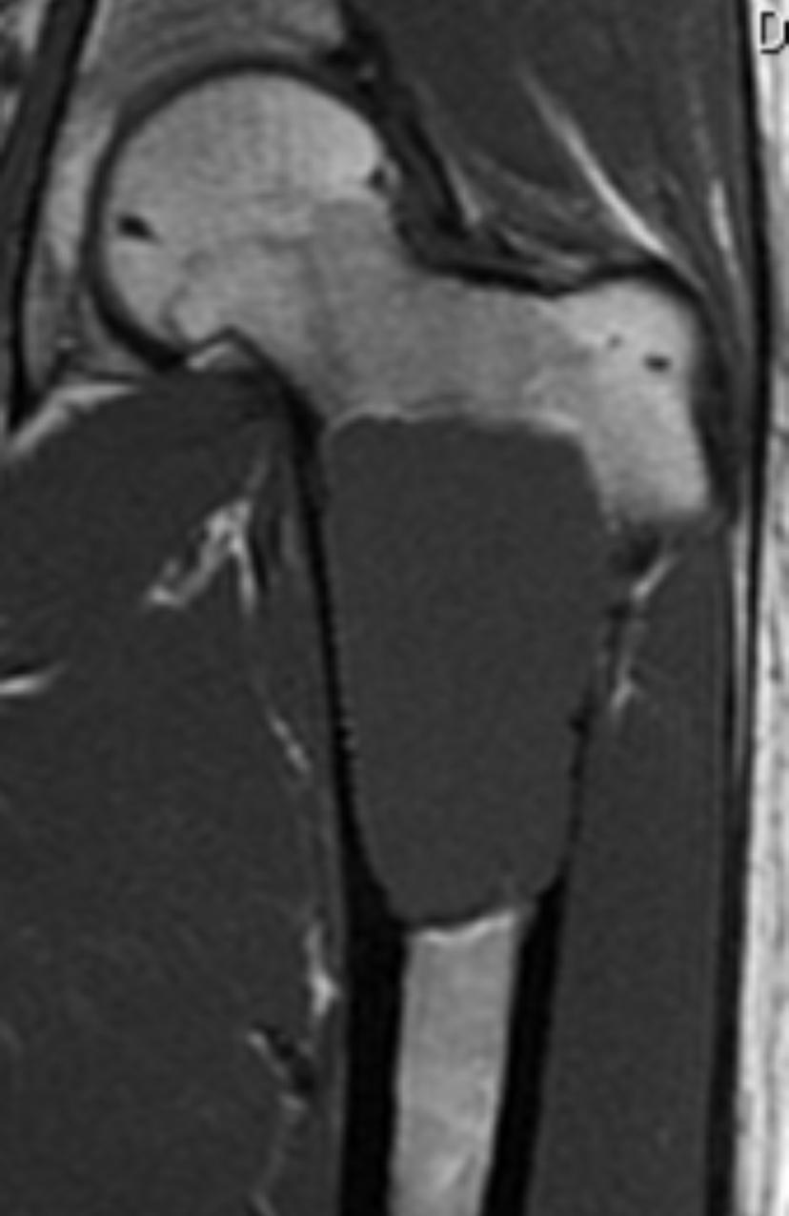
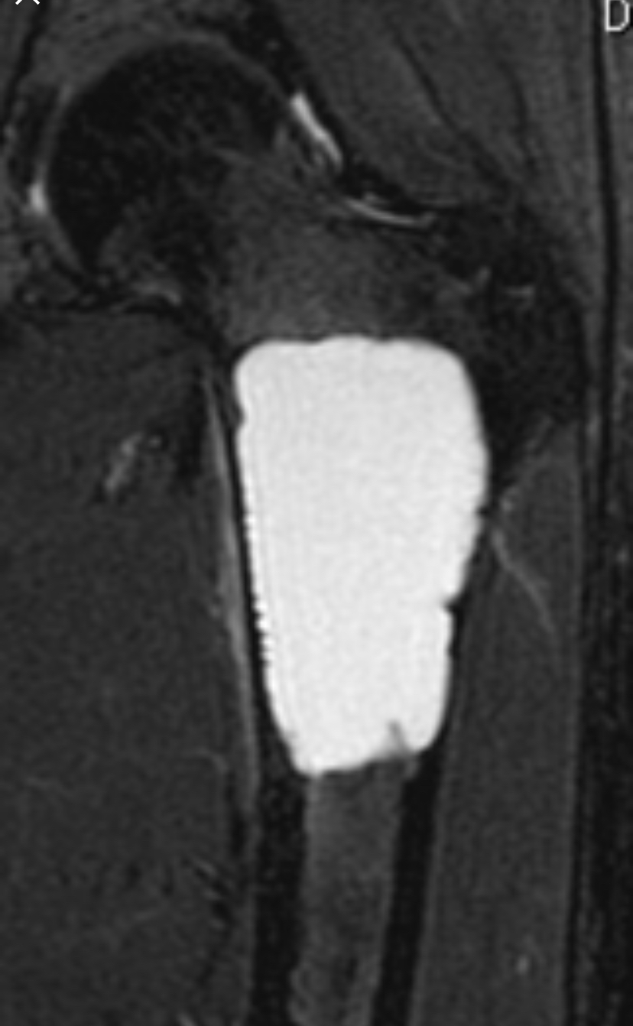

Slide 18
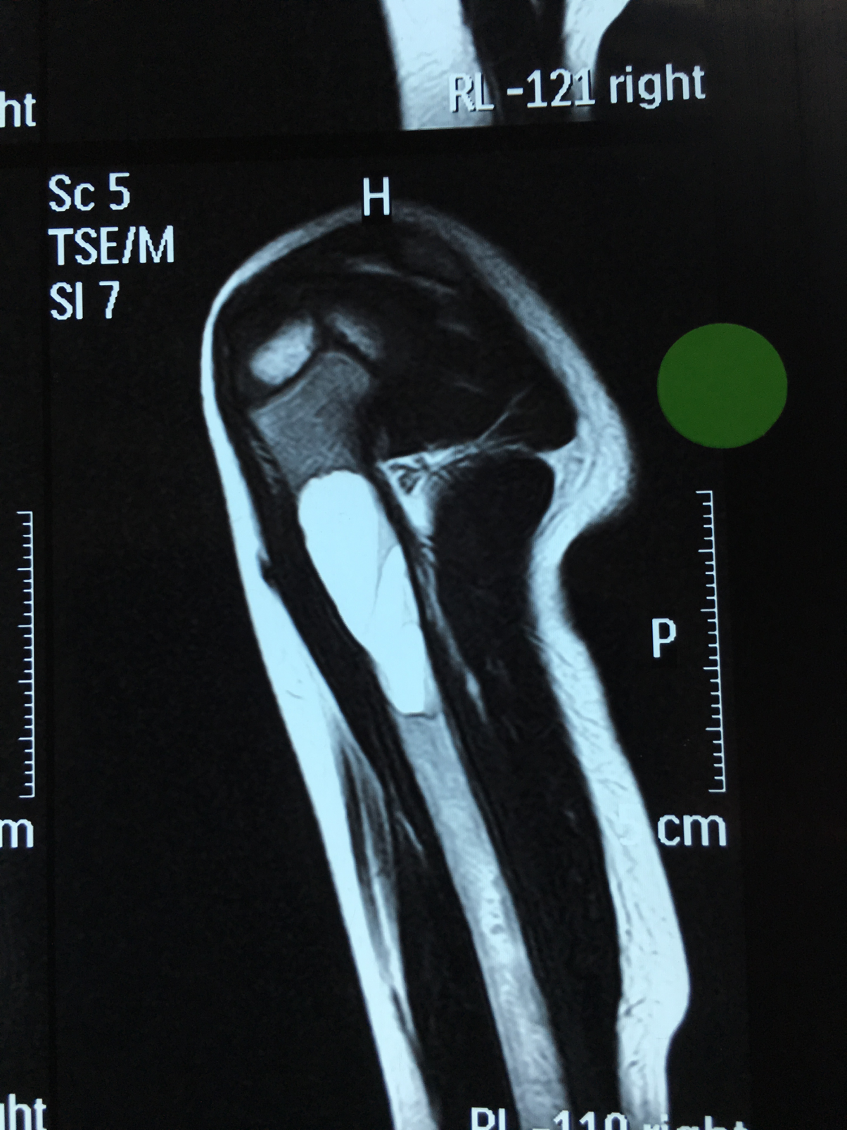
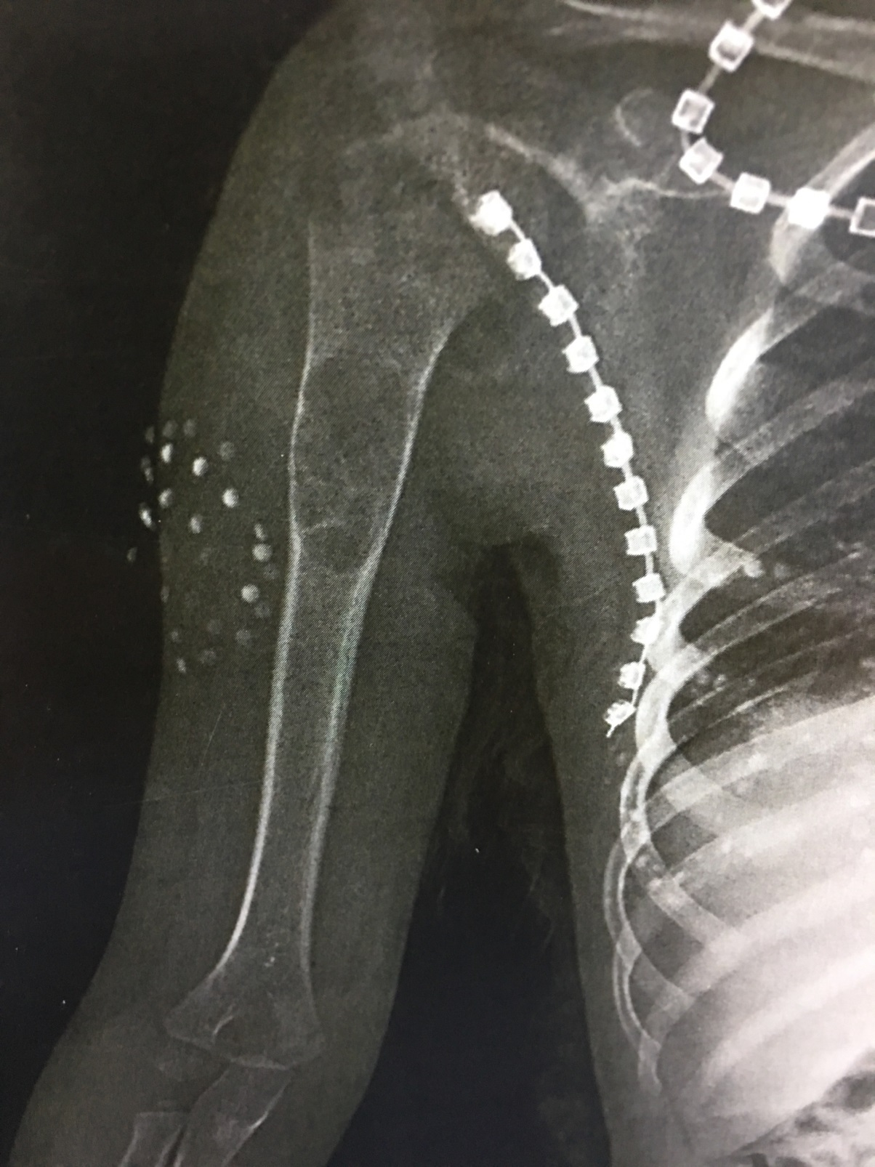

Slide 19
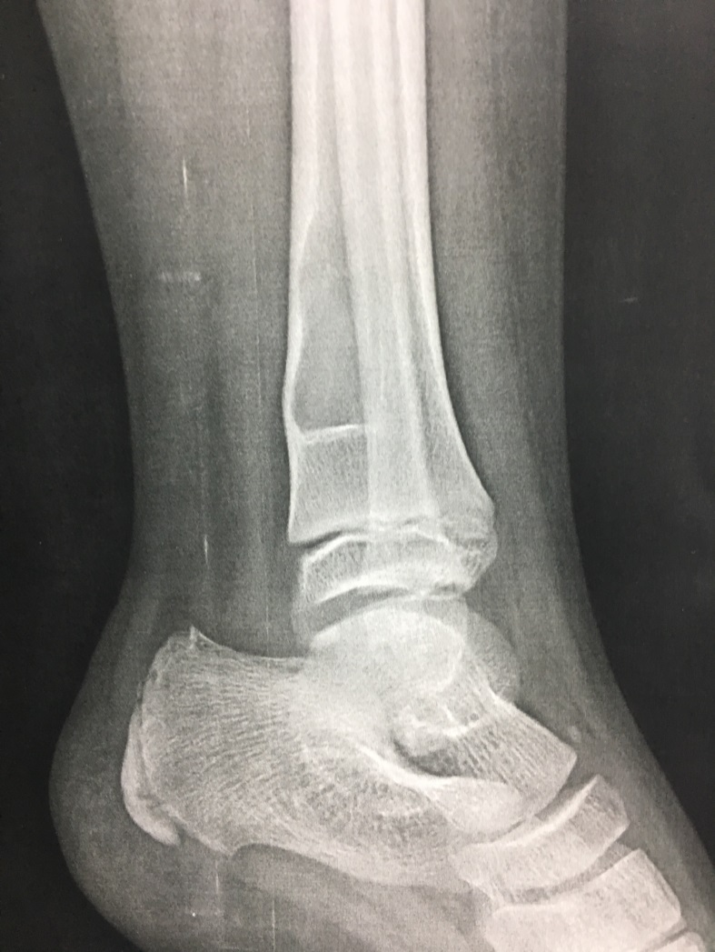
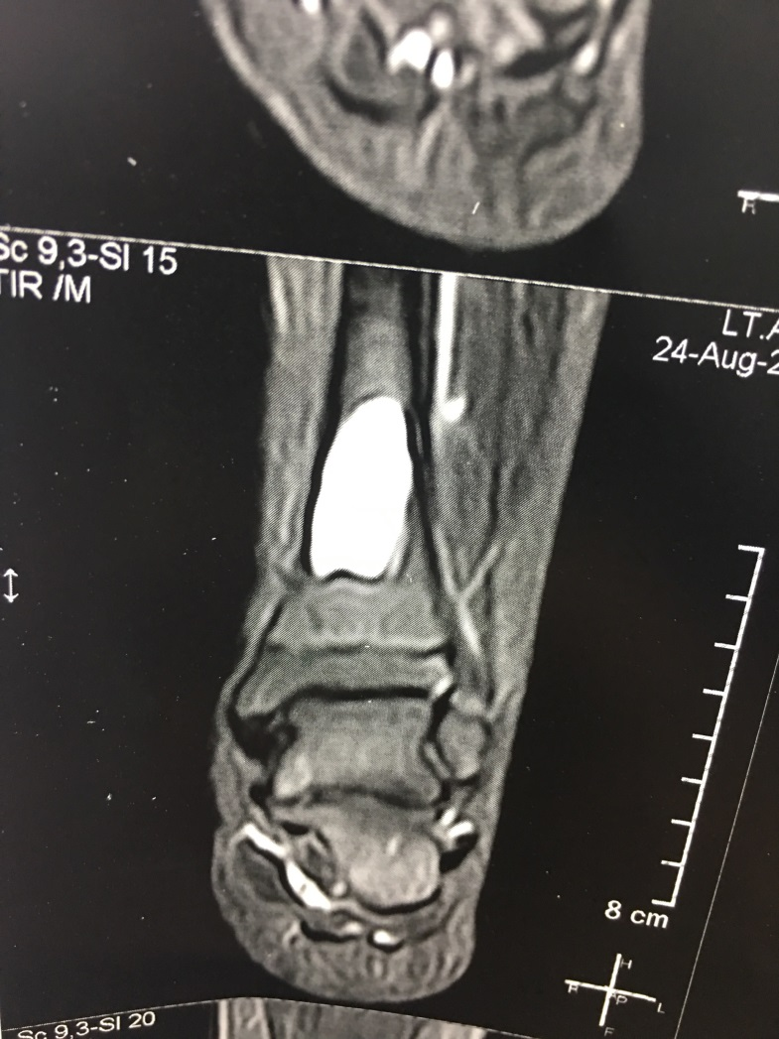

Slide 20
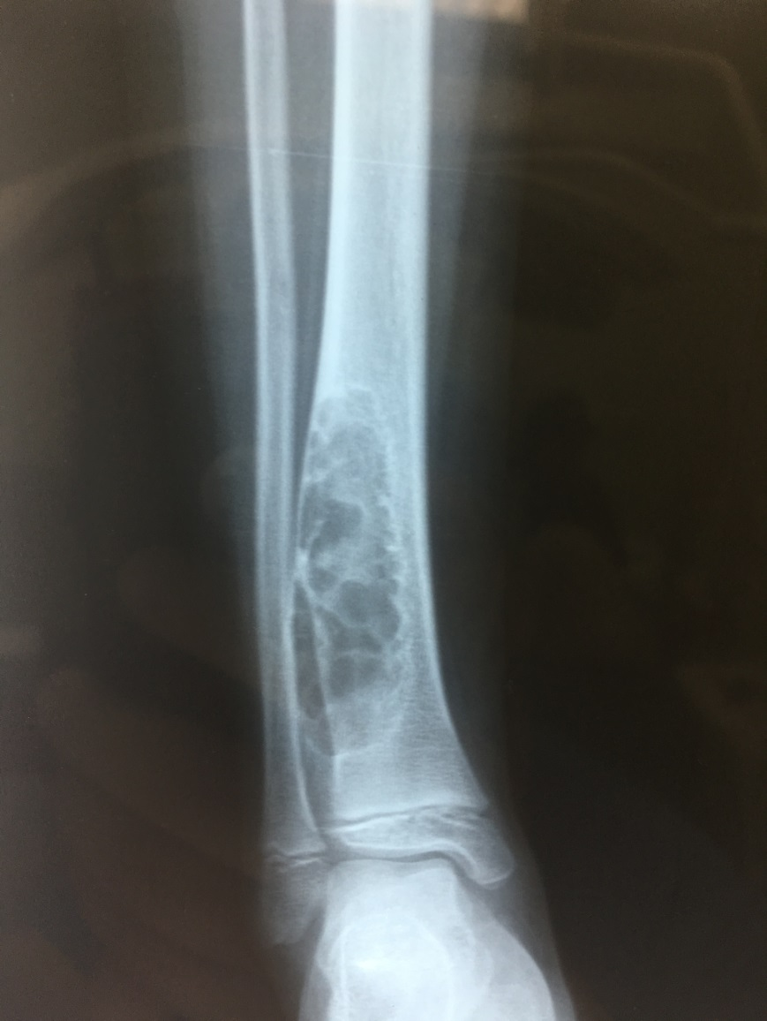
Aneurismal BONE CYST
2-ABC
Benign bone lesion with multiple blood-filled cavitie
75% of patients are < 20 yrs.
Long bones (Femur and tibia being most common) arises in the metaphysis
primary and secondary forms
Symptoms : pain and swelling
may present with pathologic fracture

Slide 21
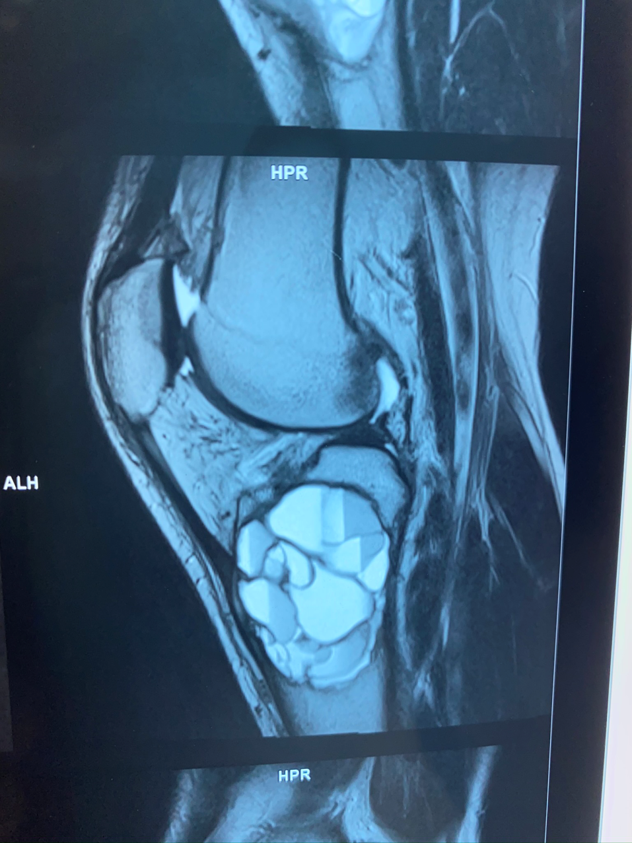
Investigations:-
PXR:- expansile, eccentric metaphyseal and lytic lesion with bony septae ("bubbly appearance")
MRI or CT scan will show multiple fluid lines
Treatment
curettage and bone grafting

Slide 22
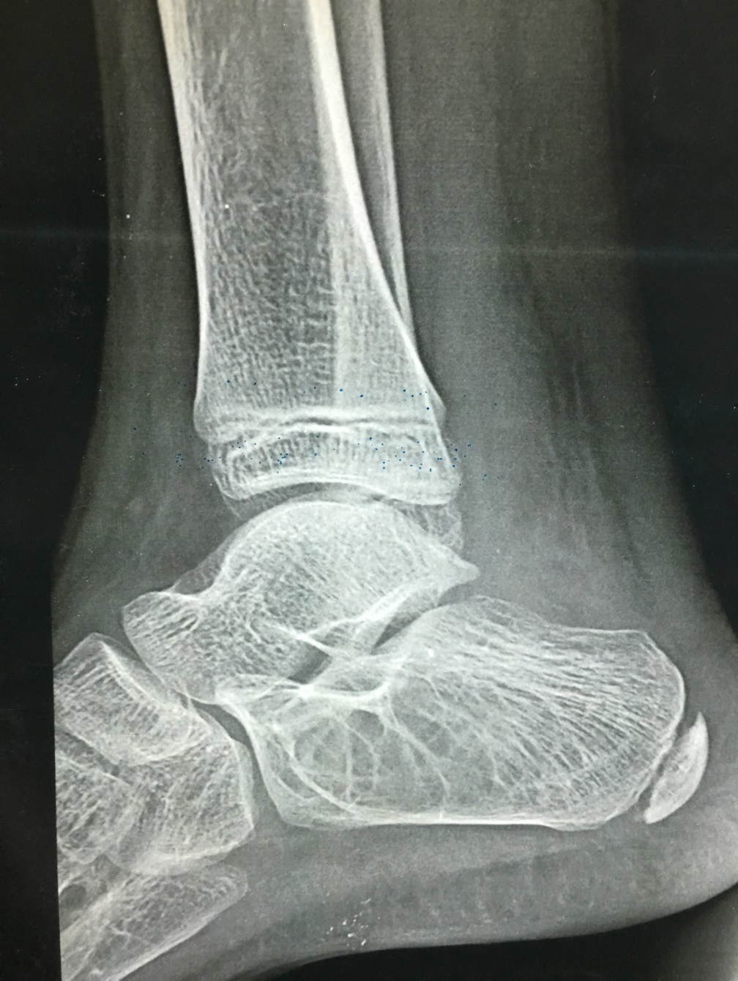
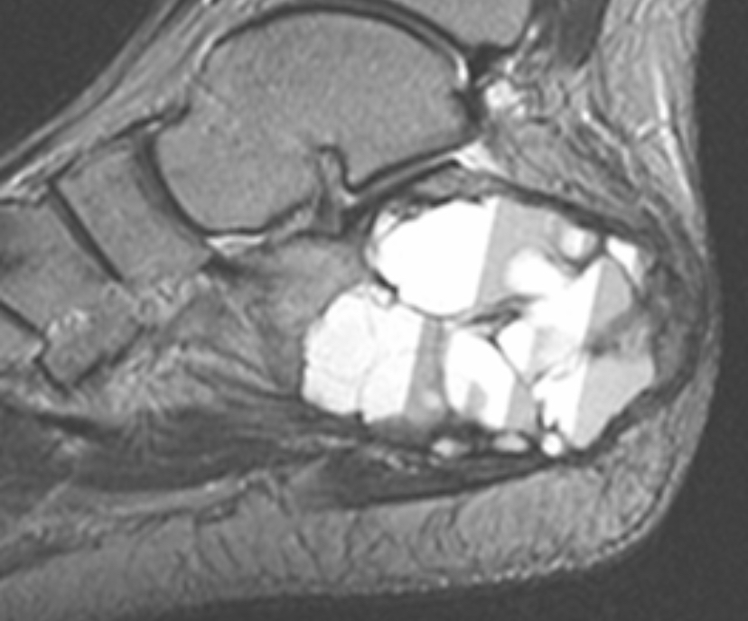

Slide 23
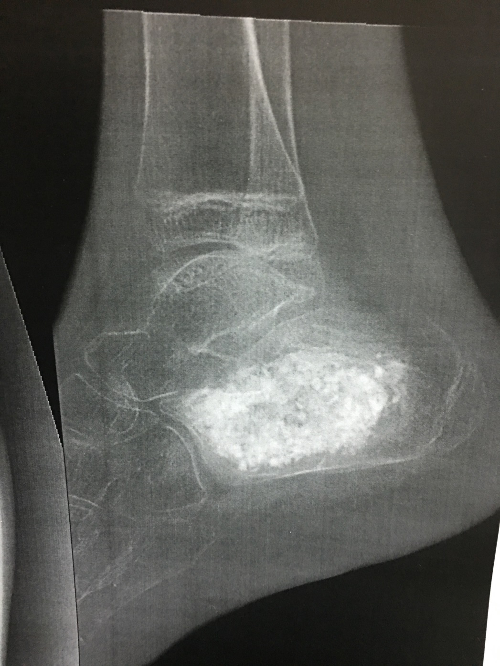

Slide 24
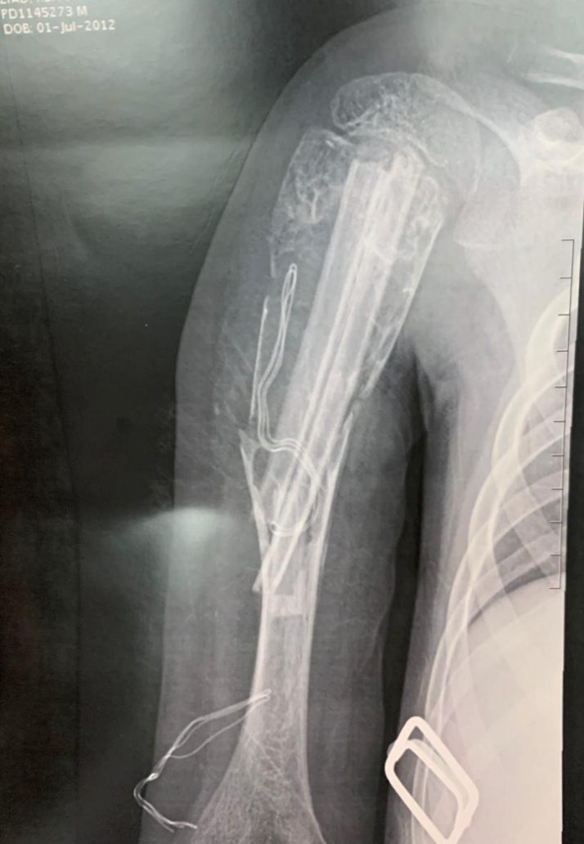

Slide 25
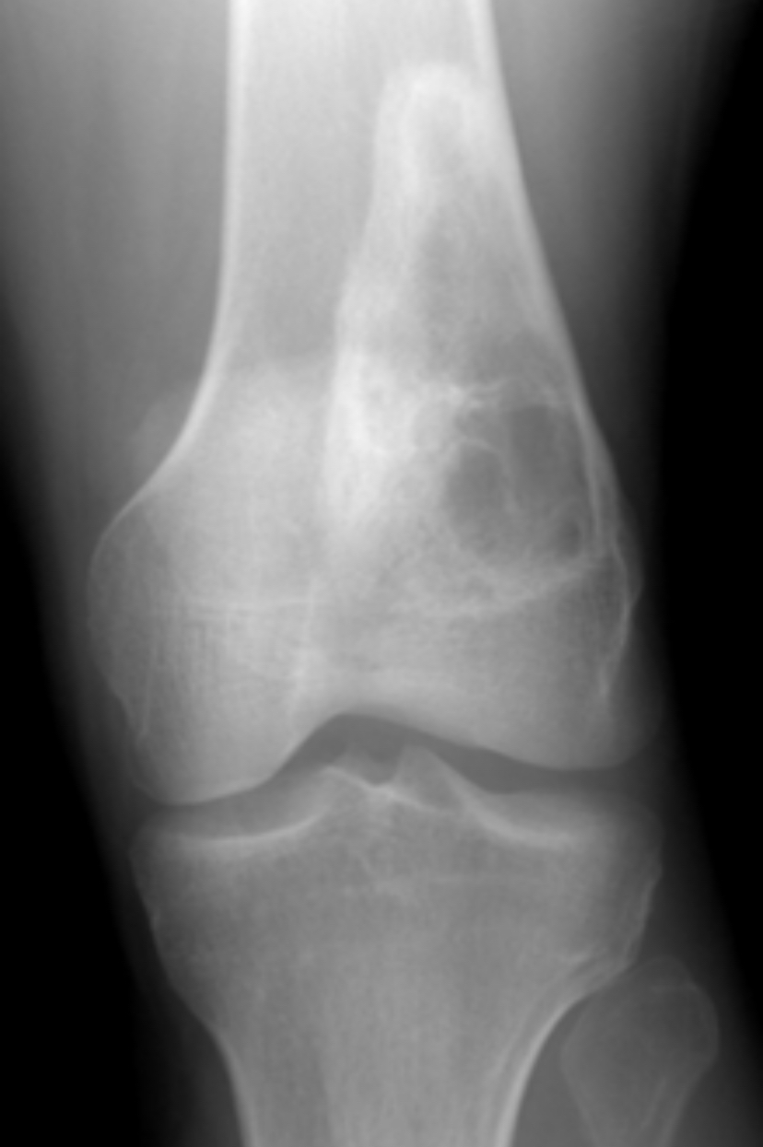
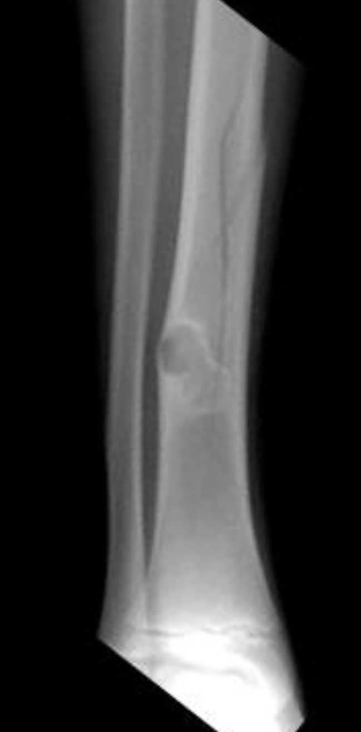
NON OSSIFYING FIBROMA
non-ossifying fibroma (NOF) is a benign fibrogenic lesion
one of the most common benign bone tumors in childhood (with osteochondroma)
Age and location
common in children 5-15 years old
metaphysis of long bones
Symptoms
Asymptomatic :-usually found incidentally
may present with pathologic fracture

Slide 26
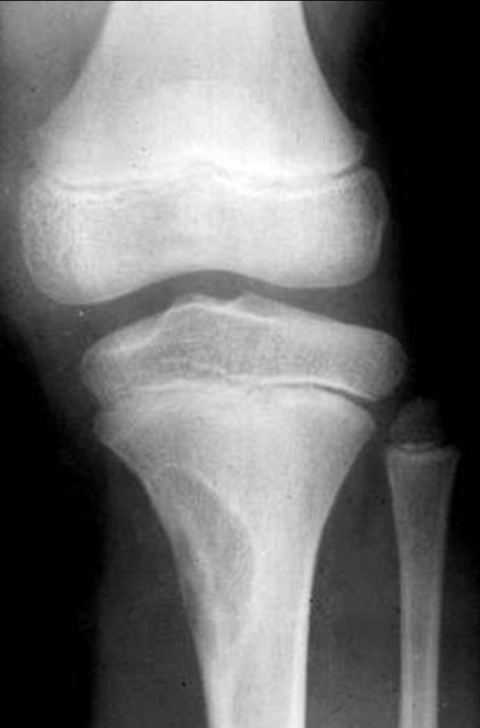
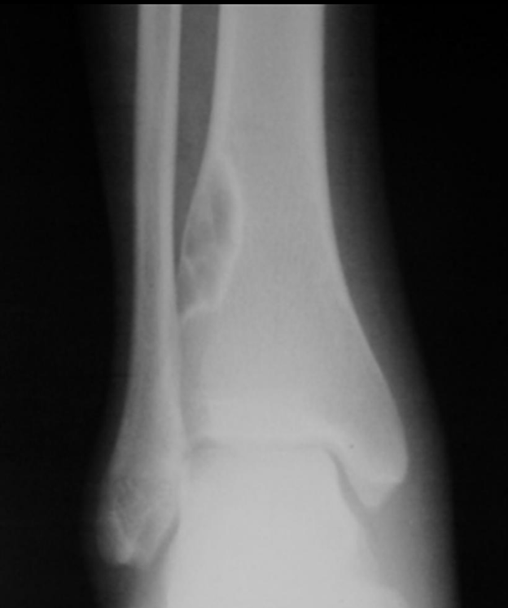
Investigations:-
PXR:-metaphyseal eccentric lytic lesion surrounded by sclerotic rim
Cortex may be expanded and thin
As patient approaches skeletal maturity, lesions become sclerotic
Treatment
observation
curettage and bone grafting
symptomatic and large lesion

Slide 27
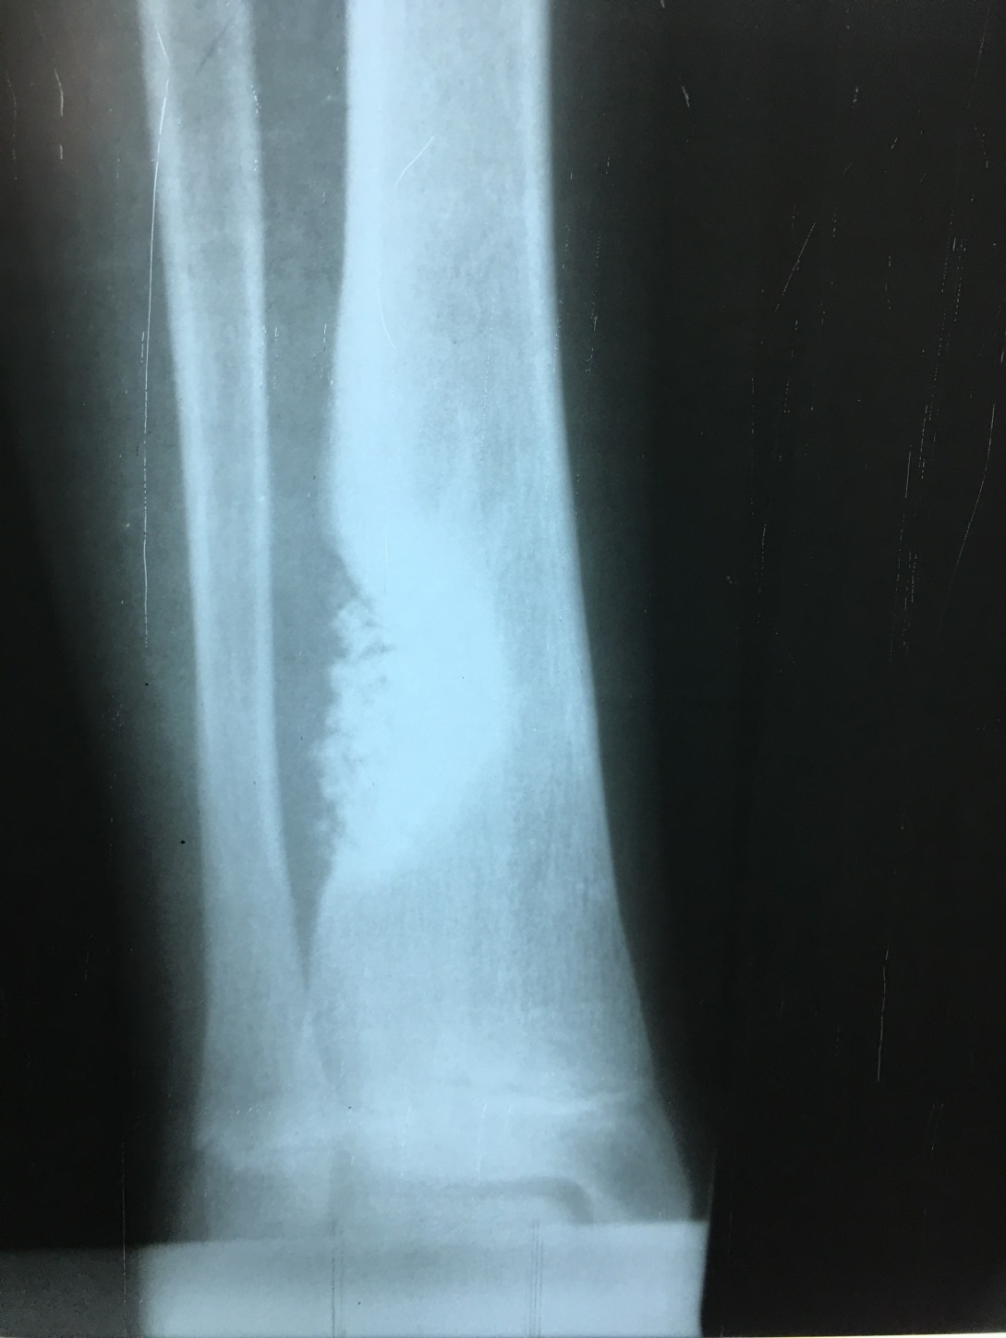

Slide 28
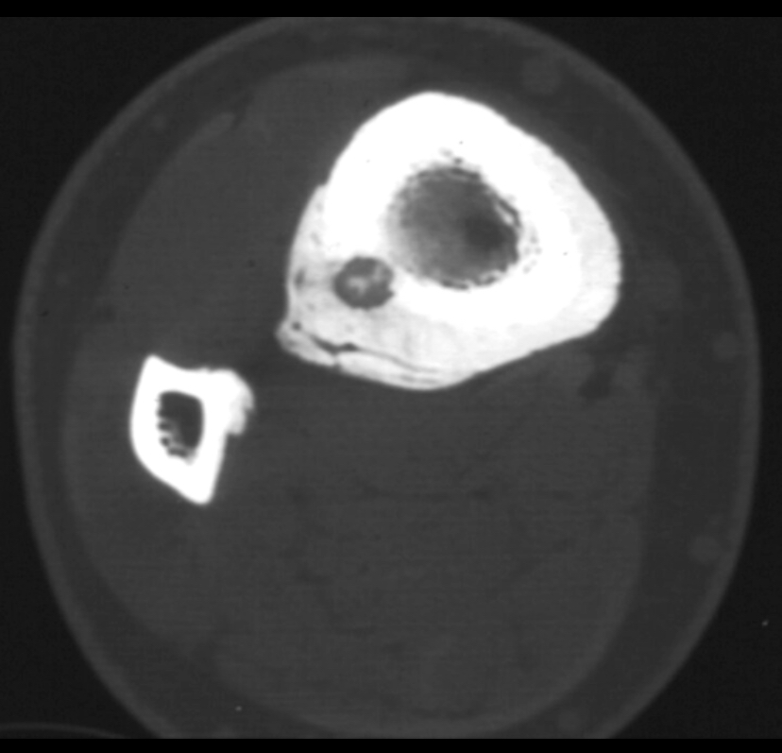
Osteoid osteoma
A small, painful, benign cortical bone lesion
Proximal femur, tibia, hand , feet and spine
pathoanatomy
nidus
central nodule of woven bone and osteoid
reactive zone
area of thickened bone
Symptoms pain
constant and progressive
worse at night and with drinking Alcohol
relieved by NSAIDS

Slide 29
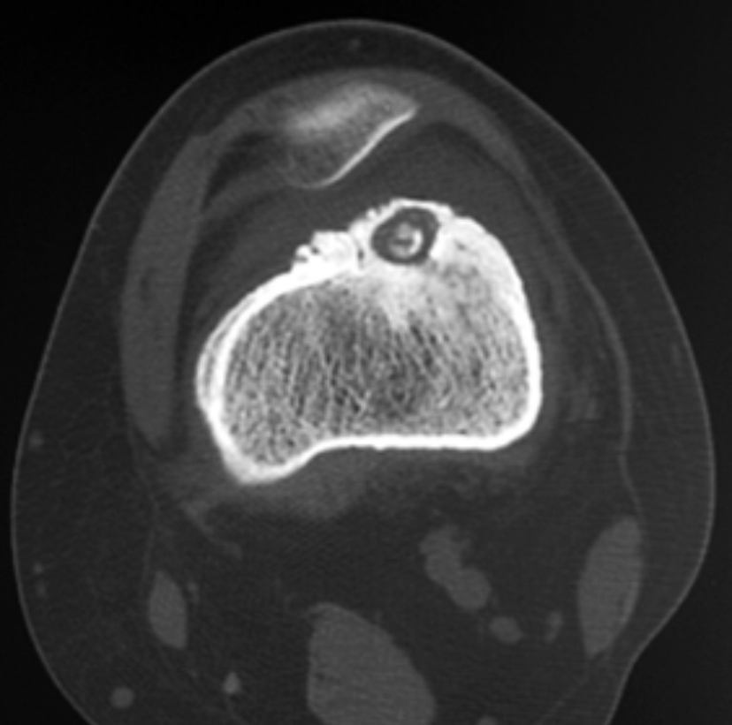
Investigations:-
PXR:- intensely sclerotic bone around radiolucent nidus
CT is the study of choice :
help to identify the location and size of nidus
usually < 1.5 cm
Treatment
Observation NSAIDS
percutaneous radiofrequency ablation
surgical resection with currettage

Slide 30
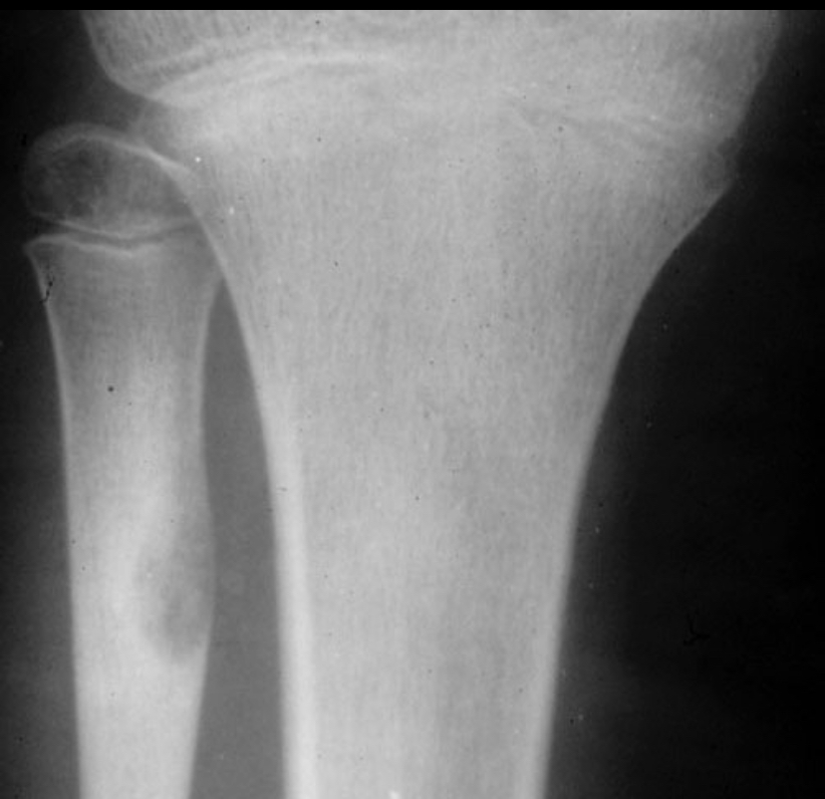
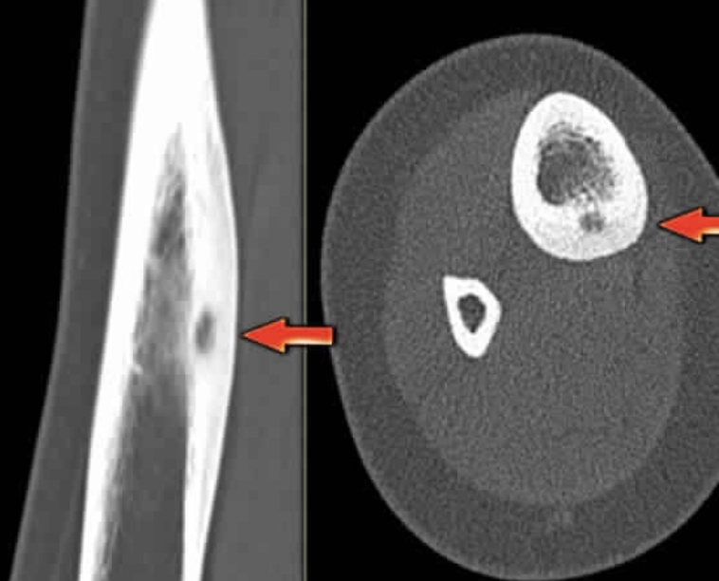

Slide 31
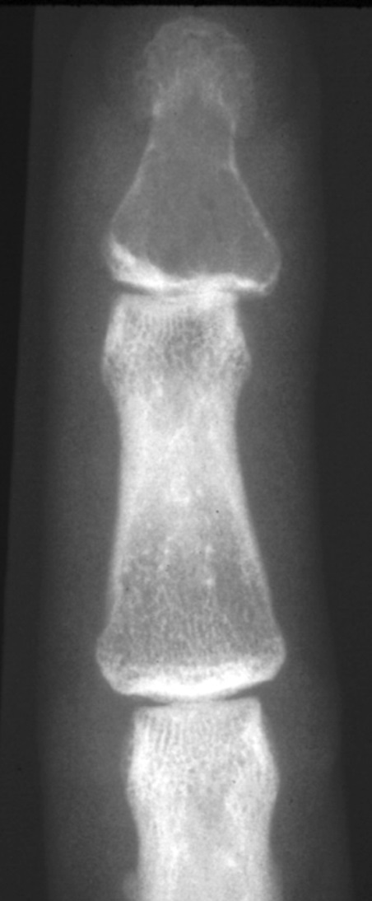
Enchondroma
A benign chondrogenic tumor composed of hyaline cartilage
the most common bone tumor in the hand is the enchondroma
20-50 year olds
usually found in the bone of hands and feet
other locations include distal femur, proximal humerus and tibia
May be solitary enchondroma or multiple
Ollier’s disease and Maffucci's syndrome (multiple enchondromatosis)

Slide 32
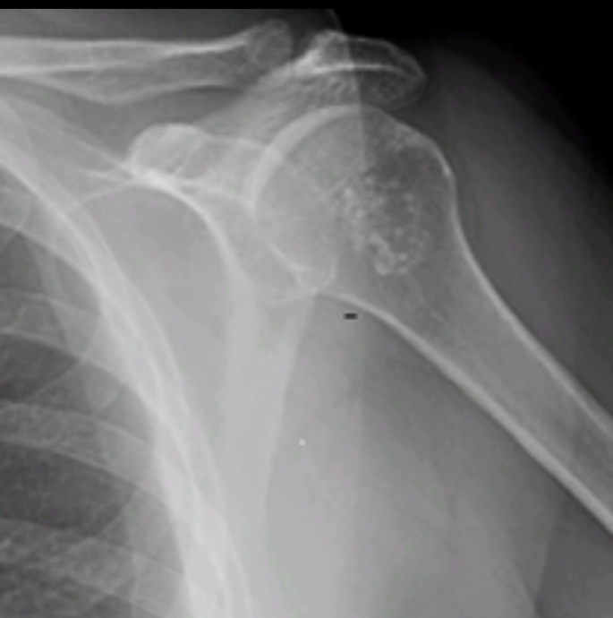
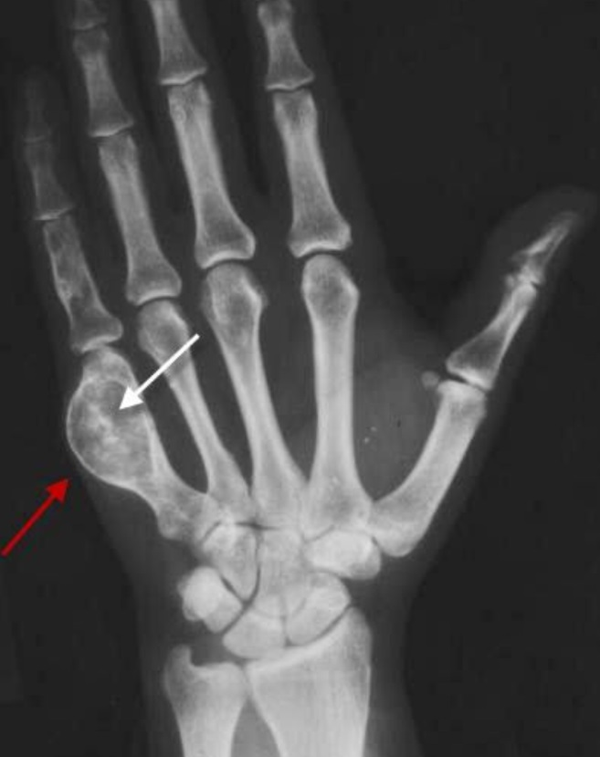
Investigations:-
PXR:- well defined, lucent, central medullary lesions that calcify over time
pop-corn" stippling or may have purely lytic appearance (especially in hand)
cortical expansion and thinning may be present in hands, feet
Treatment
Observation:- serial radiography
surgical resection with currettage

Slide 33
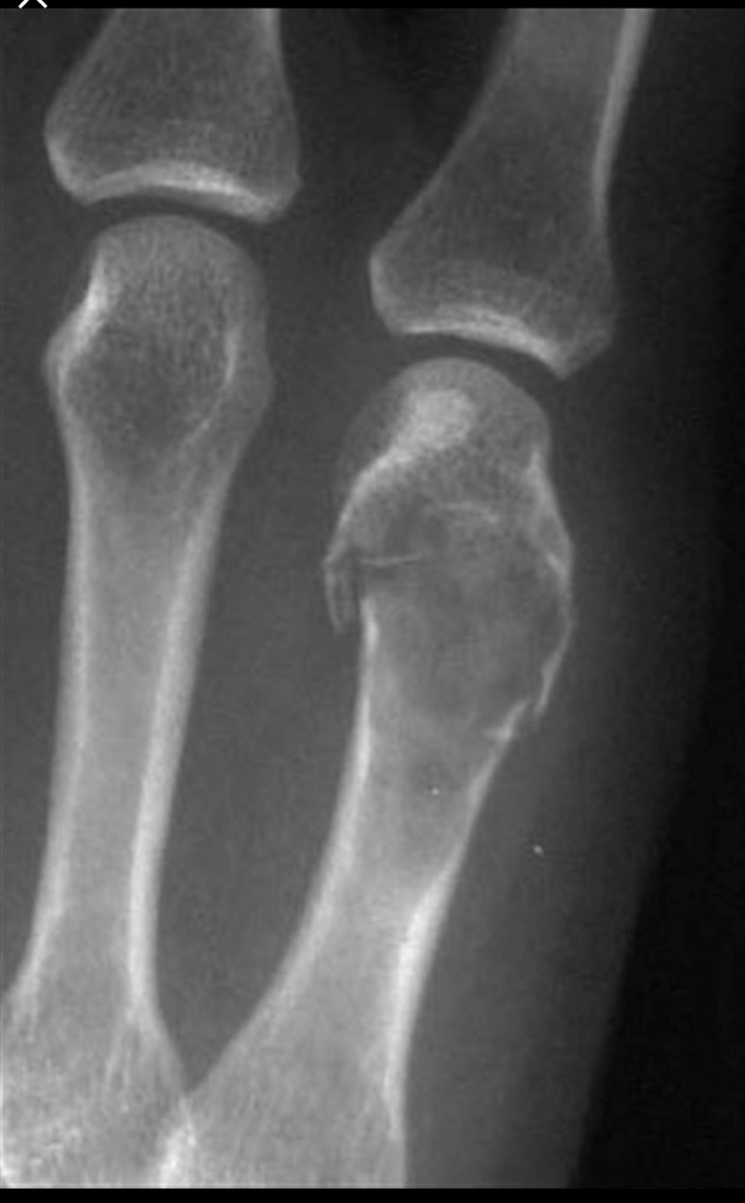
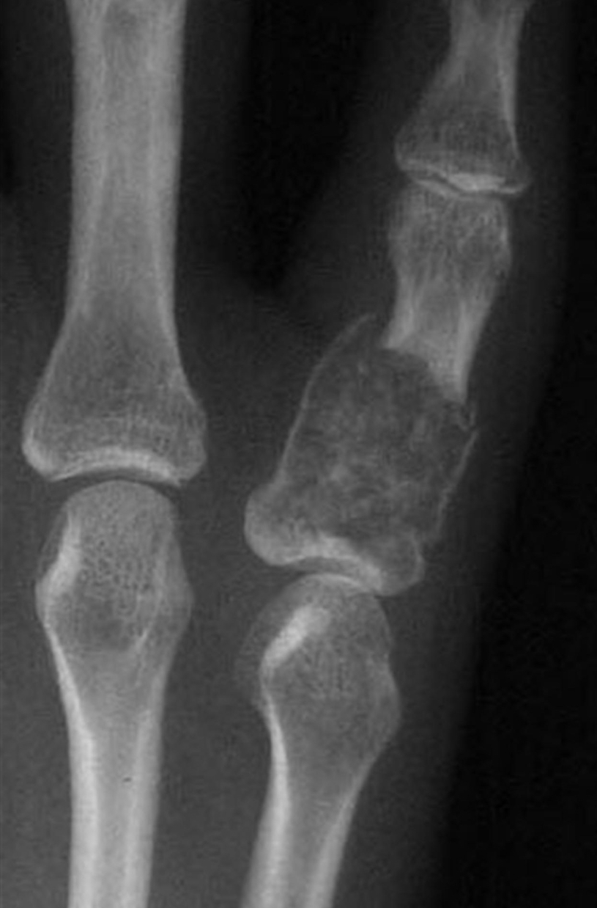

Slide 34
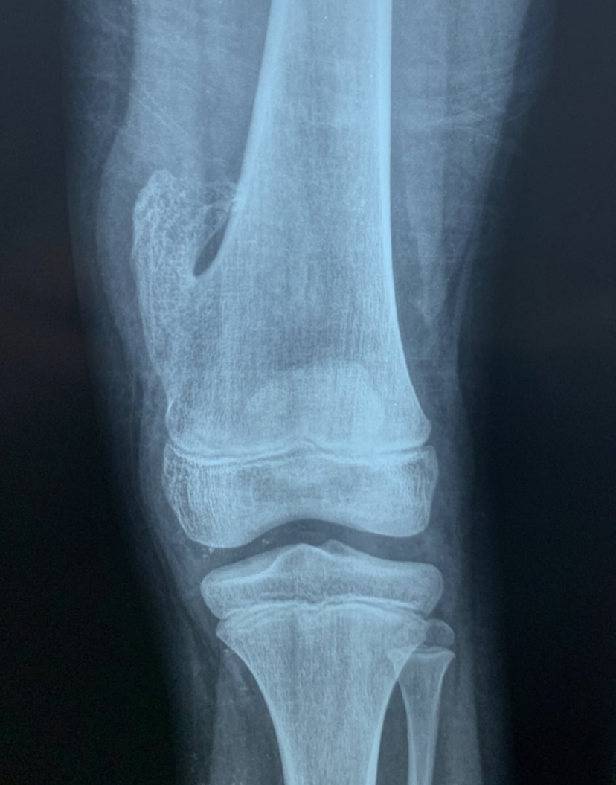
Osteochondroma
A benign chondrogenic lesion derived from cartilage from the perichondral ring that may take the form of
solitary ostoechondroma or Multiple Hereditary Exostosis (MHE)
The most common benign bone tumor
Occur on the surface of the bone around the knee in adolescents and young adults
Asymptomatic, painless mass, symptoms of neurovascular compression
They continue to grow away from joints until skeletal maturity
risk of malignant transformation is<1% with solitary osteochondroma
Signs of malignant changes???

Slide 35
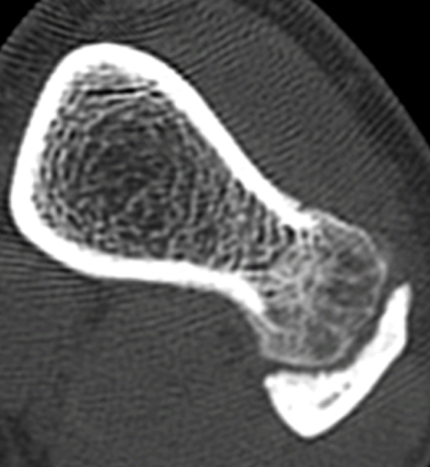
Investigations:-
PXR:- sessile (broad base) or pedunculated (narrow stalk) lesions found on the surface of bones
Cortex of the lesion continuous with cortex of the native bone
Medullary cavity of lesion continuous with medullary cavity of native bone
Cartilage cap is usually radiolucent (looks smaller than felt)
Treatment
Observation:- if asymptomatic
marginal resection at base of stalk, including cartilage cap

Slide 36
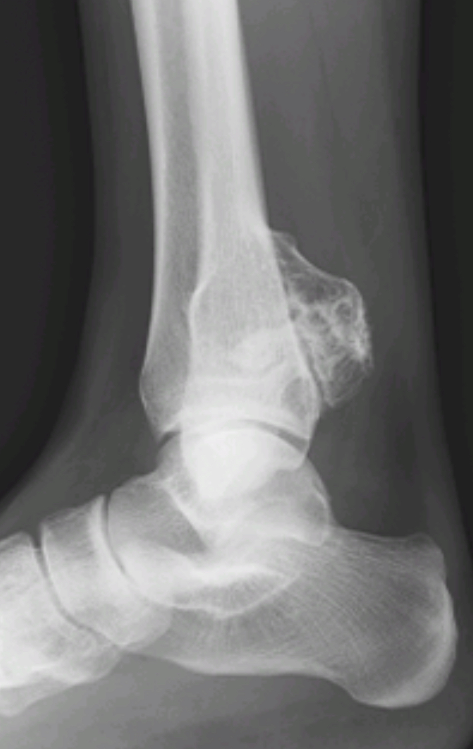

Slide 37
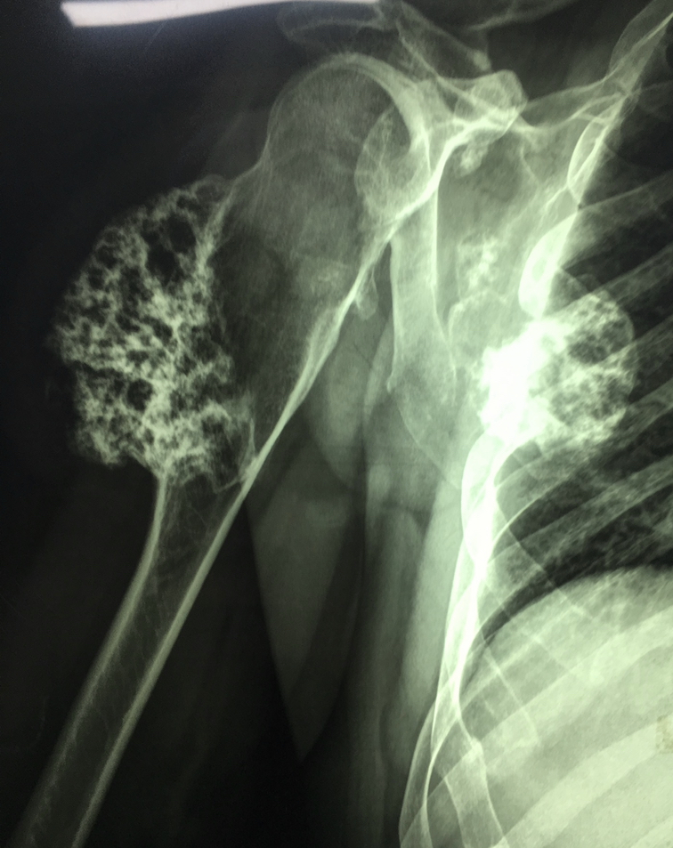
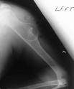

Slide 38
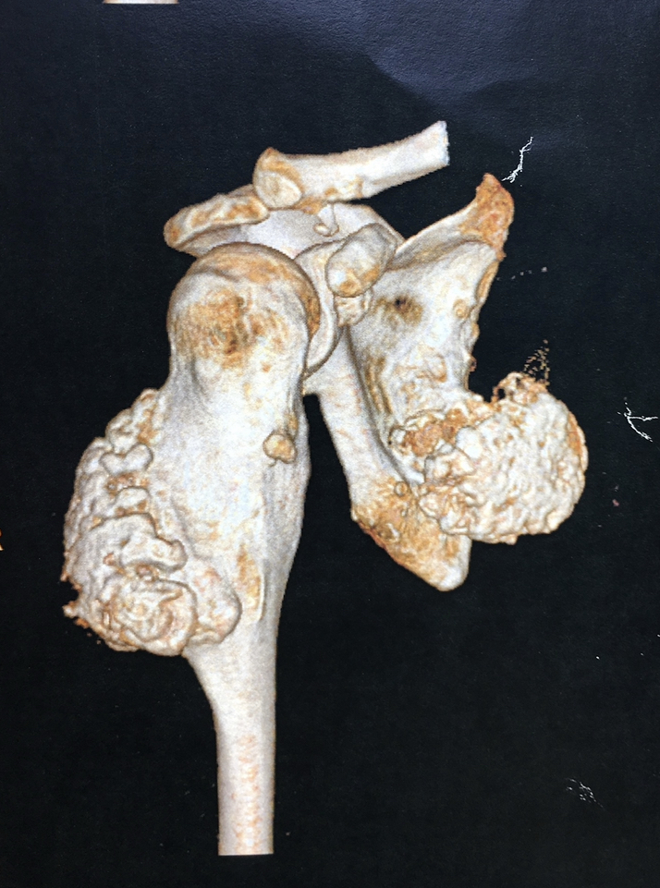
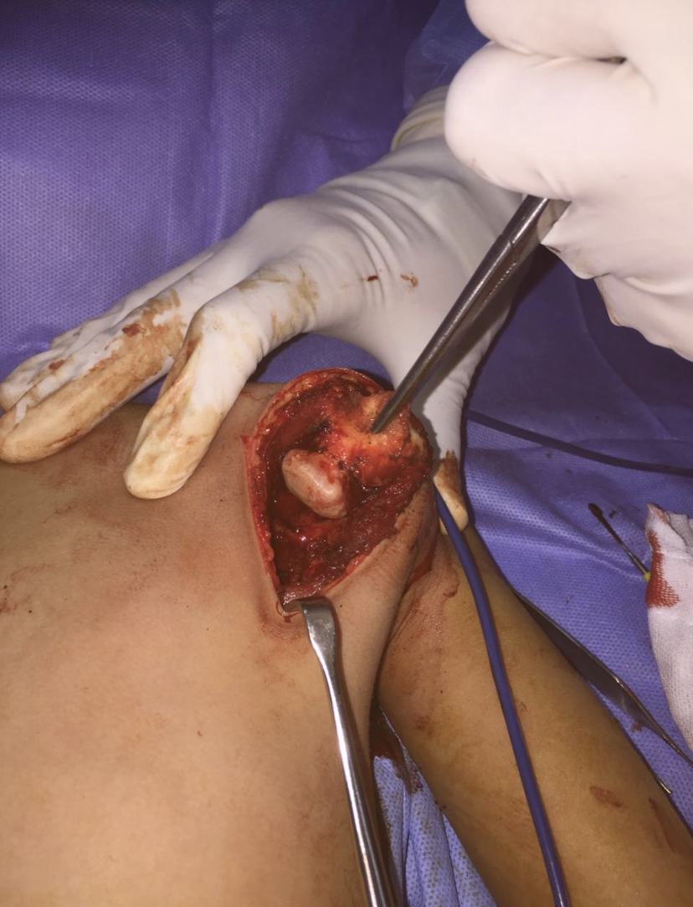

Slide 39
GCT
It is a benign aggressive tumor typically found in the epiphyseometaphyseal region of long bones, often around the knee, in young adults
Can be malignant and metastasize to lung
Symptoms
pain of the involved extremity
palpable mass
tenderness over mass
soft tissue swelling

Slide 40
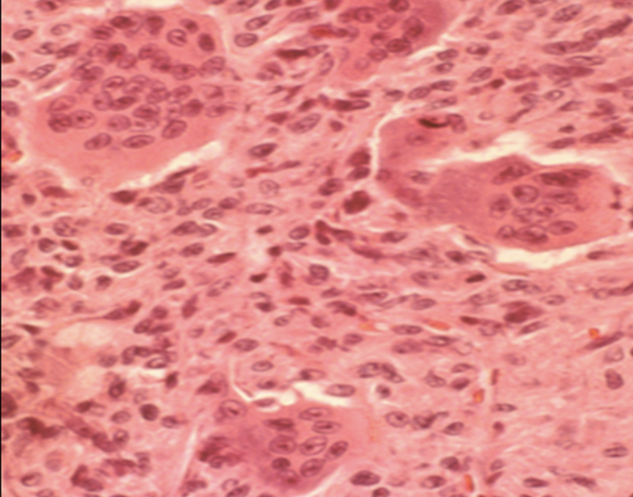
Histology:- numerous giant cells are the hallmark of this lesion
multiple nuclei (up to 50 per cell)
similar characteristics as osteoclasts and resorb bone
have same enzymes

Slide 41
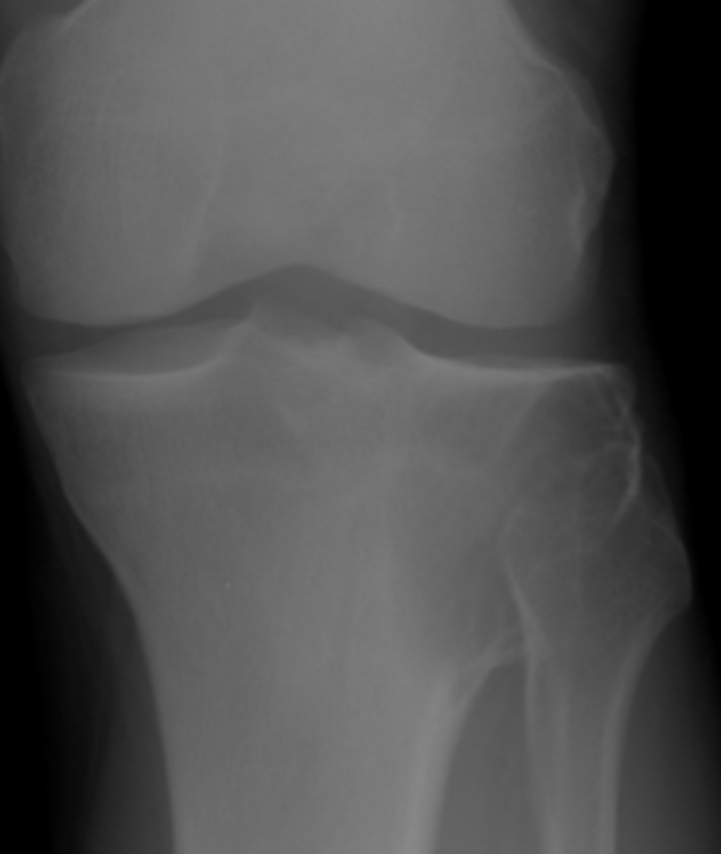
Investigations:-
PXR:- eccentric lytic epiphyseal/metaphyseal lesion with soap and bubble appearance that often extends into the distal epiphysis and subchondral bone
Treatment
extensive curettage, adjuvant treatment and reconstruction
complete resection and reconstruction for recurrence and for distal radius

Slide 42
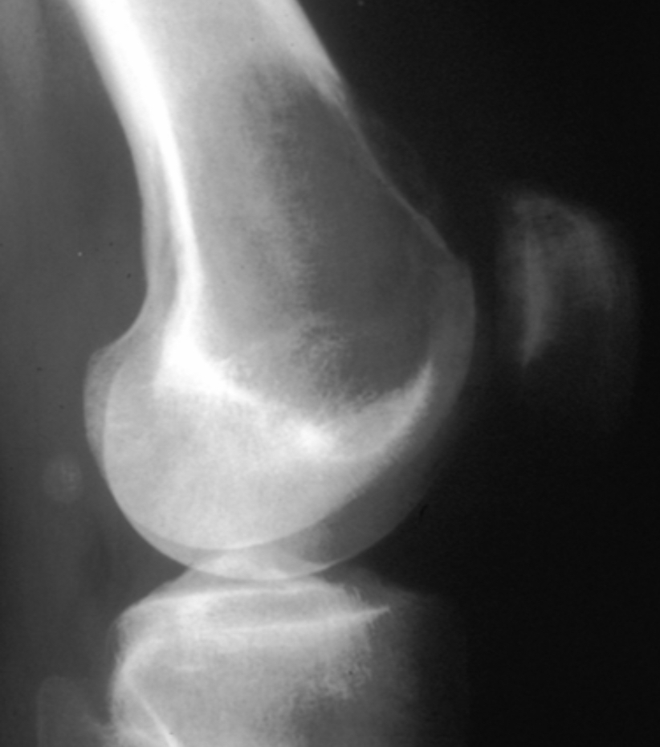
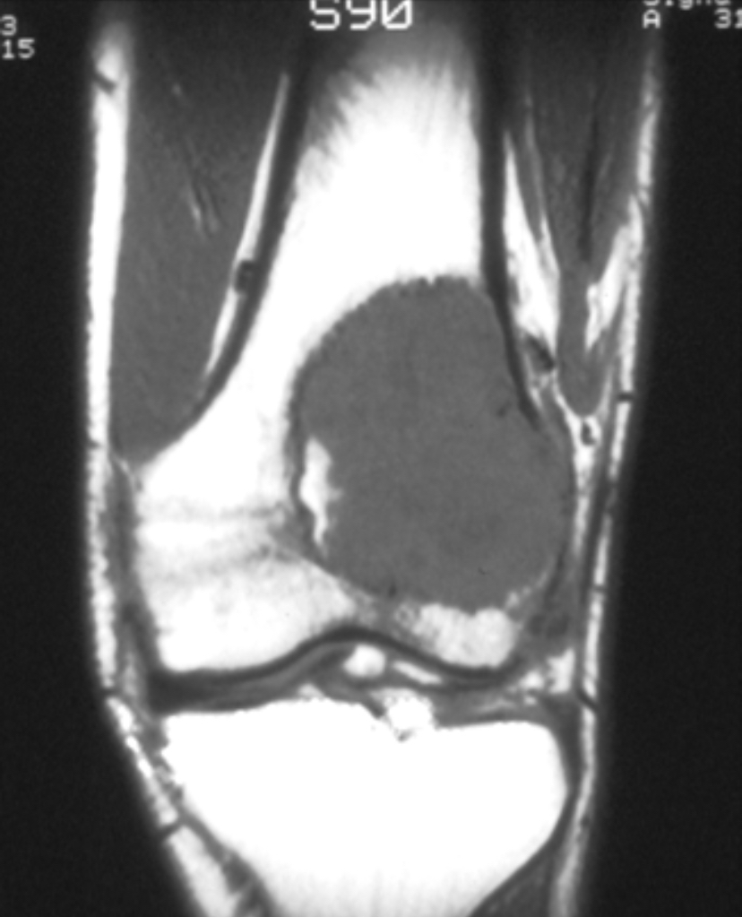

Slide 43
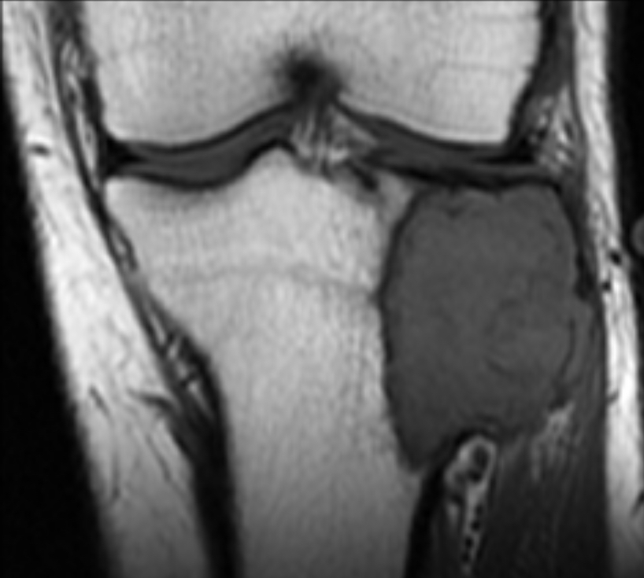

Slide 44
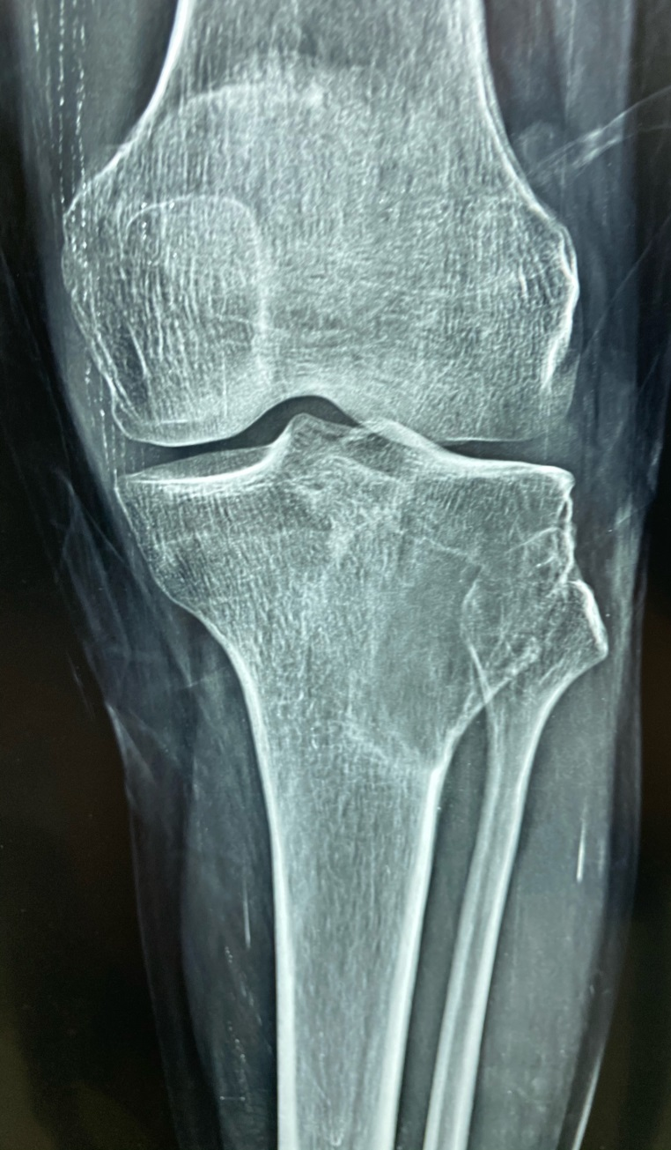
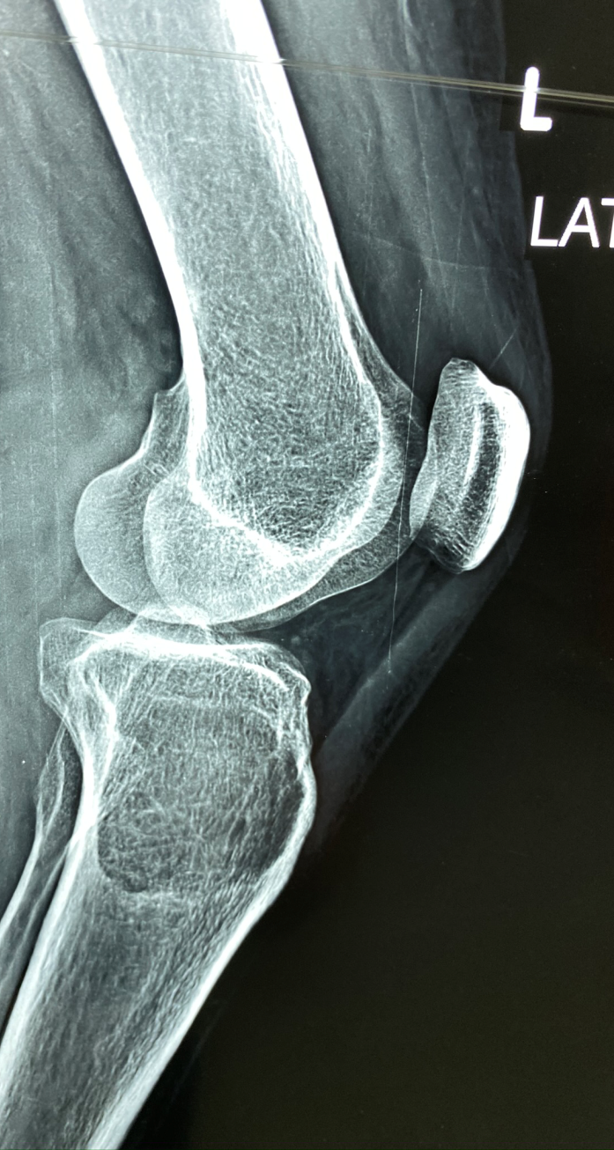
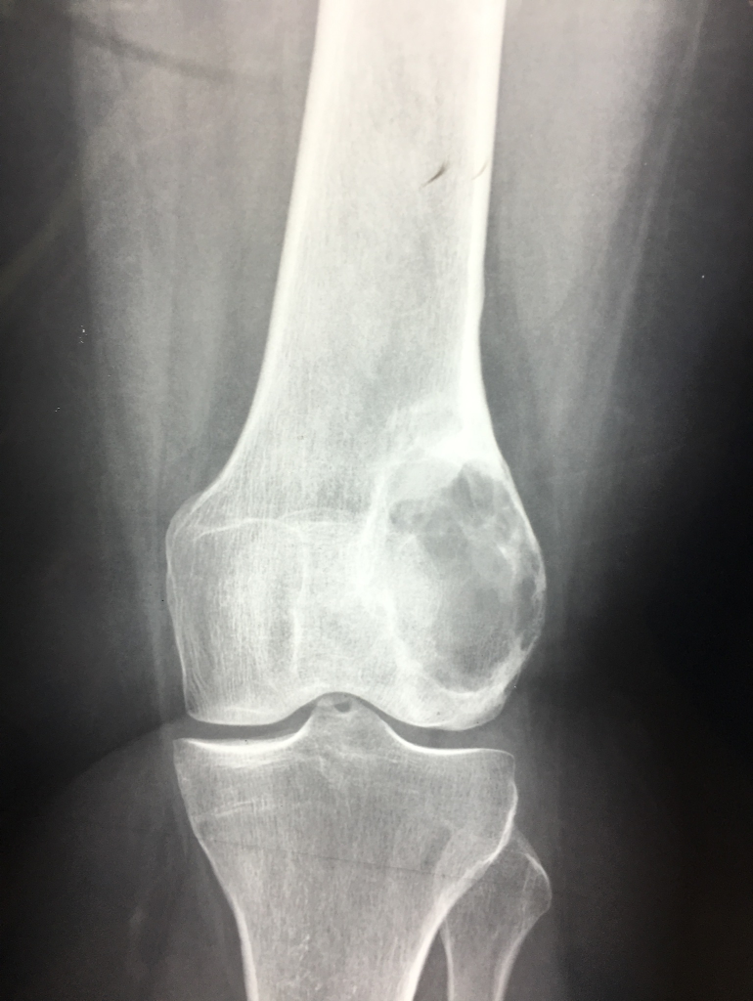

Slide 45
Malignancy

Slide 46
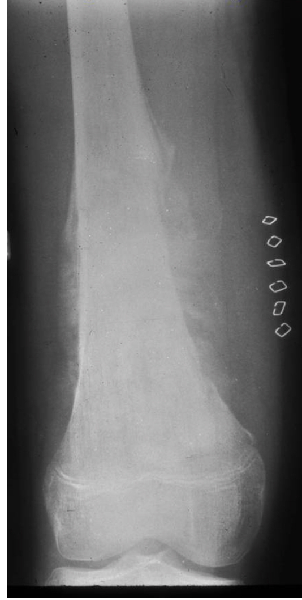
Osteosarcoma
Is a bone-producing sarcoma ; produce immature woven bone
It is the most common primary cancer of bone in children and adolescents
Primary Osteosarcoma: arises from the bone in the absence of a precursor lesion
Secondary Osteosarcoma: arises from a precursor lesion or one that is metastatic from a primary osteosarcoma

Slide 47
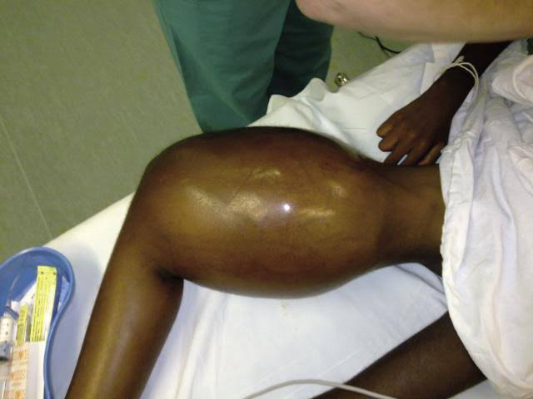
Age/Signs/Symptoms
15-25 years: Most common age is in childhood and adolescence
Mild Pain for weeks-months
Pain gradually becomes more severe & accompanied by swelling and limitation of motion
Weight loss

Slide 48
Anatomic sites
Long Bone metaphysis (Most common)
Distal Femur: most common site
Skip metastases: metastases within the same bone as the primary osteosarcoma
may dictate that the entire bone be surgically removed

Slide 49
Gross Pathology:
Osteosarcomas are composed of ossified or non-ossified tissue
Ossified tissue is yellow-white and hard
Less ossified tissue is soft
osteosarcomas penetrate the cortex and form a large extraosseous soft tissue mass
Foci of hemorrhage and necrosis are common
Periosteal reactions such as the Codman's triangle are apparent at periphery of soft tissue mass

Slide 50
Radiology
X-Ray: Osteosarcoma Of Distal Femur lesion mixed lytic and sclerotic metadiaphyseal origin ossified soft tissue mass
Codman’s triangle periosteal reaction
Sun ray appearance

Slide 51
MRI Best for:
determining intraosseous extent (size) of the tumor and size of the soft tissue component
determining relationship of tumor to neurovascular structures
detecting skip metastases
Entire bone and adjacent joint should be visualized

Slide 52
CT Scan of the Chest: Used to detect pulmonary metastases
Whole Body Bone Scan: Used to detect bone metastases, extent of bony involvement by the tumor and presence of skip metastases
Biopsy

Slide 53
Treatment
osteosarcomas treated with a combination of chemotherapy and wide excision.
usually, chemotherapy is administered before and after surgery
chemotherapy before surgery = preoperative = neoadjuvant chemotherapy
chemotherapy after surgery = adjuvant chemotherapy

Slide 56
Ewing sarcoma
small round cell sarcoma
5-25 years of age
Found in the diaphysis of long bones
Genetics t(11:22) translocation
found in 95% of cases
Presentation
May present with pain, fever, weight loss, leukocytosis and increased erythrocyte sedimentation rate mimicking osteomyelitis

Slide 57
poor prognostic factors
tumor size/location
age
elevated lactic dehydrogenase levels (>200IUml) indicates large tumors
Metastases and chemotherapy response

Slide 58
PXR
large destructive lesion in the diaphysis or metaphysis
lesion may be purely lytic or have variable amounts of reactive new bone formation
periosteal reaction may give "onion skin"
Bone scan
MRI shows a large soft tissue component

Slide 59
Histology
sheets of small round cells
prominent nuclei and minimal cytoplasm
may have pseudo-rosettes (circle of cells with necrosis in center)

Slide 60
chemotherapy + radiation therapy for non-resectable tumors
chemotherapy + limb salvage resection ± adjuvant radiation

Slide 61
Multiple myeloma
Multiple myeloma is a neoplastic proliferation of plasma cells that presents with skeletal lesions
Cancerous plasma cells accumulate in the bone marrow and crowd out healthy blood cells.
The cancer cells produce abnormal proteins that can cause complications.
Neoplastic plasma cells produces abnormal immunoglobulins and results in osteoclastic stimulation by malignant cells

Slide 62
patients > 40 years of age (median age is 60)
Symptoms
usually presents with
localized bone pain (usually spine or ribs)
pathologic fracture
fatigue secondary to anemia, renal insufficiency, hypercalcemia

Slide 63
Radiographs findings
multiple "punched-out" lytic lesions
Bone marrow aspirate >10-30%plasma
(normal amount of plasma cells on bone marrow aspirate is < 2%)
Bone scans cold in 30%
skeletal survey

Slide 64
Serum labs
anemia
elevated creatinine
hypercalcemia
due to excessive resorption of bone
ESR often elevated
SPEP (serum protein electrophoresis)
50% IgG
Urine
proteinuria
UPEP (urine protein electrophoresis)
may show Bence Jones proteins (secreted immunoglobulin kappa and lambda light chains)

Slide 65
multiagent chemotherapy
surgical stabilization and external beam radiation therapy

Slide 66
THANK YOU

